Slide 1

VISUALIZING BIKE ACCIDENTS IN OTTAWA USING MAPBOX
BEN KENNEDY
Notes:
Slide 1: Title
Mapbox is a suite of products that gives an incredible amount of control over map design, all in geojson format
Link maps to html documents using a url to the style you’ve created
Lots of example projects and code snippets available

Slide 2
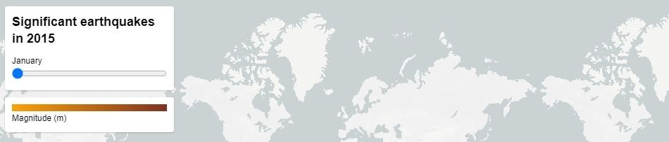
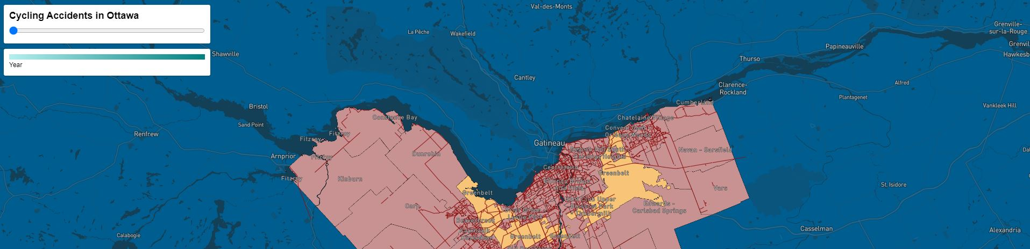
Top: A Mapbox example of a map with a time slider
Bottom: In-Development Web Map
Notes:
Slide 2: Pictures
Top is an example of a time slider functionality in Mapbox → easy to design and implement yourself, even with a more basic understanding of the various languages involved
Bottom is an example of my in-development map as it appears in chrome (via html) with the time slider functionality looking very nearly the same as mapbox’s

Slide 3
Why Use Mapbox?
Mapbox provides a comprehensive API to implement various user-interactive features (such as a time slider or popup)
Mapbox pages can be easily hosted on Github
Mapbox uses a tiered pricing model which means it is highly accessible
Mapbox studio provides a simple, web-based GUI to perform most of the basic formatting for your map
Notes:
Slide 3:
So why mapbox? – Examples of useful aspects of the tools

